Slide 1


21 DAYS OF
MACHINE LEARNING
8/21
---Code Warriors---

Slide 2

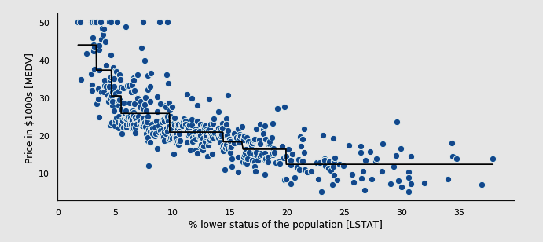
What is Decision Tree Regression
Decision tree is a flowchart like tree structure, where each internal node denotes a test on an attribute, each branch represents an outcome of the test, and each leaf node( terminal node ) holds a class label.
---Code Warriors---

Slide 3
What is CART
CART
Classification Trees
Regression
Trees
---Code Warriors---

Slide 4
Decision Tree Flow Chart
X₁ < 20
Yes
No
X₂ < 200
X₂ < 170
Yes
No
Yes
No
300.5
65.7
X₁ < 40
1023
Yes
No
-64.1
0.7
---Code Warriors---

Slide 5
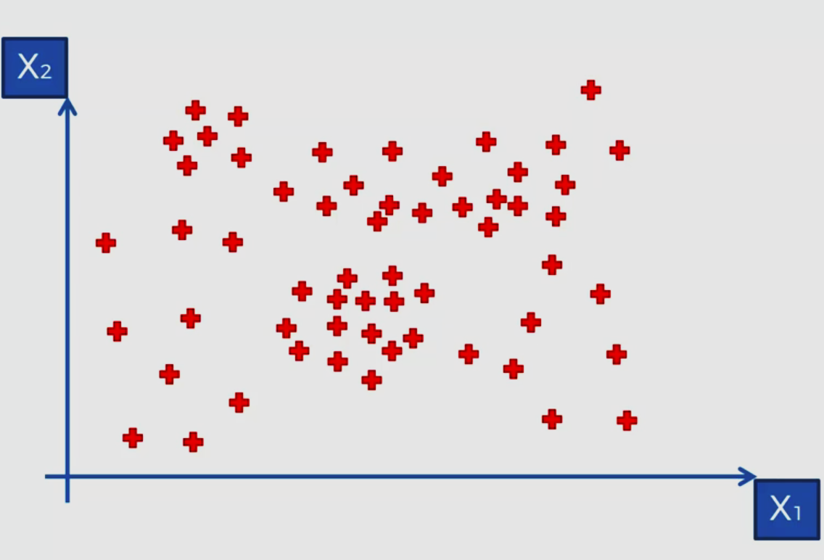
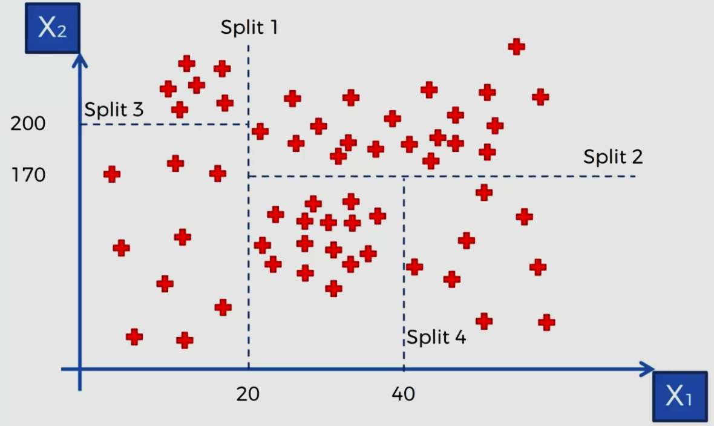
Working of Decision Tree
---Code Warriors---

Slide 6
Decision Tree Regression Model
1
from sklearn.tree import DecisionTreeRegressor
2
Regressor = DecisionTreeRegressor(random_state = 0)
3
Regressor.fit(X_train,y_train)
4
y_pred = regressor.predict(X_test)
---Code Warriors---

Slide 7
Decision Tree Regression
Advantages
Dis-Advantages
Compared to other algorithms decision trees requires less effort for data preparation during pre-processing.
A decision tree does not require scaling of data as well.
Missing values in the data also does NOT affect the process of building decision tree to any considerable extent.
A small change in the data can cause a large change in the structure of the decision tree causing instability.
Decision tree often involves higher time to train the model.
For a Decision tree sometimes calculation can go far more complex compared to other algorithms.
---Code Warriors---

